Slide 1
Pedestrian safety factors & actions
Stephen Read, P.E.
November 2023

Slide 2
Overview
Provide briefing on efforts to combat the increasing total and pedestrian deaths and serious injuries on Virginia’s roadways
Provide awareness on:
Virginia’s Strategic Highway Safety Plan related actions
Fatal and serious injury crash numbers and trends
Highway Safety Improvement Program related spending

Slide 3
All Traffic Related Fatalities and Serious Injuries in VA

Slide 4
Strategic Highway Safety Plan: Actions to Improve Safety
Vision:
Virginia’s vision is towards zero deaths and serious injuries from motor vehicle crashes so that all roadway users arrive safely at their destination.
Mission:
To fulfill the Vision through Safe System
Collaboration with four Es of roadway safety – Education, Enforcement, Engineering, and Emergency response & medical services to achieve safe travel for a fifth E – Everyone.
https://bit.ly/VA2026SHSP

Slide 5
Strategic Highway Safety Plan (SHSP) Emphasis Areas
Notes:
SSA has 5 Elements and we added 6th Support for data analytics
We have 12 Emphasis areas with three in orange added for this period
VRU have been in all five of our SHSPs

Slide 6
2018-2022 Traffic Fatalities by SHSP Emphasis Area

Slide 7
Vulnerable Road Users
Vulnerable road user (VRU) describes those unprotected by an outside shield, as they sustain a greater risk of injury in any motor-vehicle collision.
Includes (but is not limited to): a pedestrian; a roadway worker; a person operating –
a wheelchair or other personal mobility device;
an electric scooter or similar;
a bicycle or other non-motorized means of transportation.

Slide 8
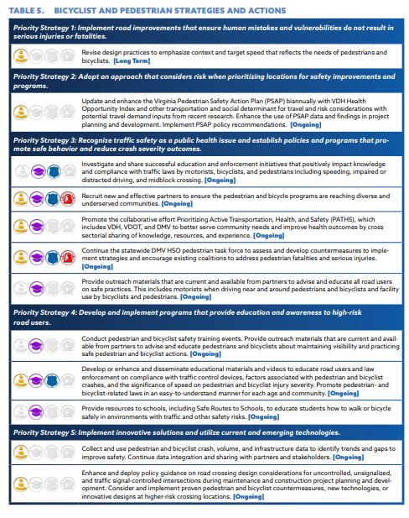
VRU Actions
12 Actions implemented by all the E’s of safety
Many are ongoing activities we are working to improve over time
Federal IIJA legislated a detailed VRU safety assessment with outreach and additional actions – under internal review for FHWA approval

Slide 9
Statewide VRU Fatalities (F) and Serious Injuries (SI)
COVID
COVID

Slide 10
VRU Injury Proportions (2018-2022)
About 1 in 3 pedestrians
and 1 in 4 bicyclists
hit by motorists were killed or seriously injured
On average, nearly 2 VRUs were killed or seriously injured every day
VRU involved crashes are 1.7 percent of all crashes, but are 16 percent of fatalities
Notes:
Fatal crashes are about 0.6% of all crashes and SI crashes are about 5% of all crashes
Almost 1 in 10 pedestrians struck were killed (9%)
Almost 3 in 10 pedestrian struck were seriously injured (28%)
About 2 in 100 bicyclists struck were killed (2 %)
About 23 in 100 bicyclists struck were seriously injured (23%)

Slide 11
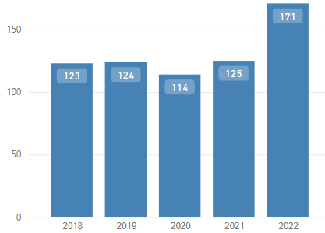
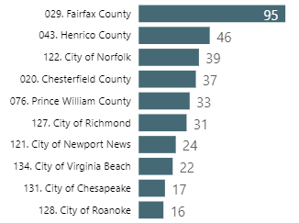
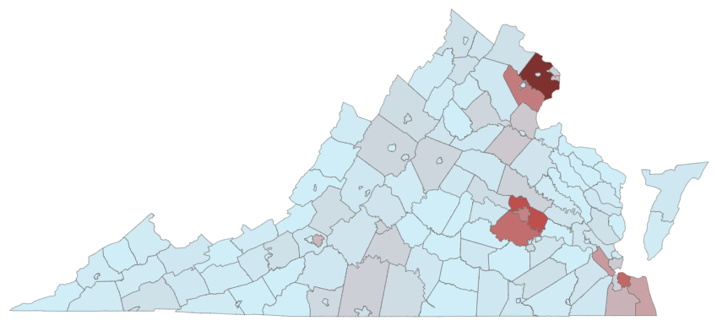
Focus: Pedestrian Crashes 2018 - 2022 Pedestrian Fatalities by Cities and Counties
657 Total
Statewide pedestrian fatalities by year
Localities with highest fatalities- 2018-2022 totals
132 pedestrian fatalities per year on average
Notes:
Top ten shown with top twenty including more cities in Hampton Roads and counties in other MPO areas.

Slide 12
Who: Pedestrian Fatalities by Age

Slide 13
Where: Summary by System and Area Type
18% are rural roadway fatalities
236 (36%)
227 (35%)
82% are urban roadway fatalities
97 (15%)
83 (13%)
63% are on VDOT roadways
Note: Work zone-related crashes are NOT included (total 643) for remaining analyses
36-39% of pedestrians were drunk or drugged in Urban areas
2% occurred in work zones (summarized in a separate assessment)
Notes:
4 of every 5 are on urban classified roadways and 3 of 5 are on VDOT maintained roads.
Primary Arterial Freeways and Expressways in Limited Access are a mix of VDOT Primaries and Toll Roads as well as third party Toll roads

Slide 14
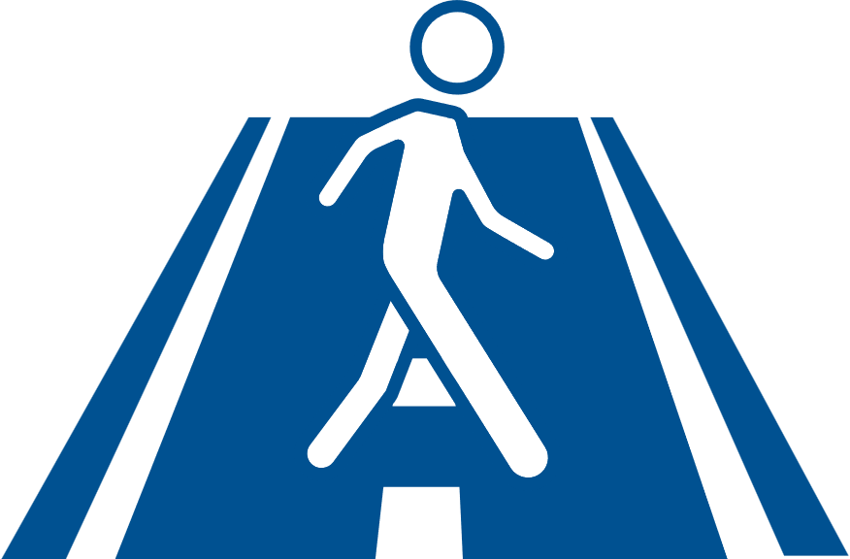
Where: Non-Freeway System Facility Contexts
 | % Share of Pedestrian Fatalities* | % of Fatalities on Arterials
Urban Locality | 42% | 75%
Urban VDOT | 41% | 88%
Rural VDOT | 17% | 62%
On urban roads 50% are within 500ft of a Bus Stop
26% are within 150ft of a Bus Stop
Arterials account for 30% of rural and 33% of urban VMT on non-limited access roadways**, but 80% of all fatalities took place on arterials
56% are
Pedestrians crossing the road
44% are in the road or on a facility
* Excludes limited access and work zone data
**2022 data
Arterials account for 81% of all urban fatalities and 62% of all rural fatalities
Notes:
Arterials are the major thoroughfares that are typically signed as State or US routes on our Primary System, but some are county routes. In urban area they typically have multiple lanes and are have higher posted speeds except in central business areas.
Arterials account for 81% of all urban fatalities and 62% of all rural fatalities

Slide 15
What: Pedestrian Fatality Action Trend
+19
+14
80% happened at night
“At intersection” is within 150 feet, so some are crossing outside of intersection “box” defined by roadway edge extensions.
40% are crossing
76% are crossing
70% happened at night
Notes:
Only Peds killed on non-freeways in five years shown (643)
Between = 351/643 = 45.4%
Crossing Between intersections 139/351 = 39.6%
Crossing at intersections (143+80)/292=76.3%
Total crossing = 362/643= 56.3%

Slide 16
Demographics Where Pedestrian Crashes Occur
Social Vulnerability
The degree to which a community exhibits certain social conditions, including high poverty, low percentage of vehicle access, age cohorts
The demographic estimates and socio-economic data presented in the following charts are based on the American Community Survey (ACS) data from the years 2016 to 2020.
VRU Vulnerability Investigated
Socioeconomic Status
Household Characteristics
Racial & Ethnic Minority Status
Housing Type & Transportation
Below 150% Poverty Line
Aged 65 & Older
Hispanic or Latino (of any race), Black and African American, American Indian and Alaska Native, Asian, Native Hawaiian and Other Pacific Islander, Two or More Races, Other Races
No Vehicle
Unemployed
Aged 17 & Younger
No High School Diploma
Civilian with a Disability
No Health Insurance
Virginia Department of Transportation

Slide 17
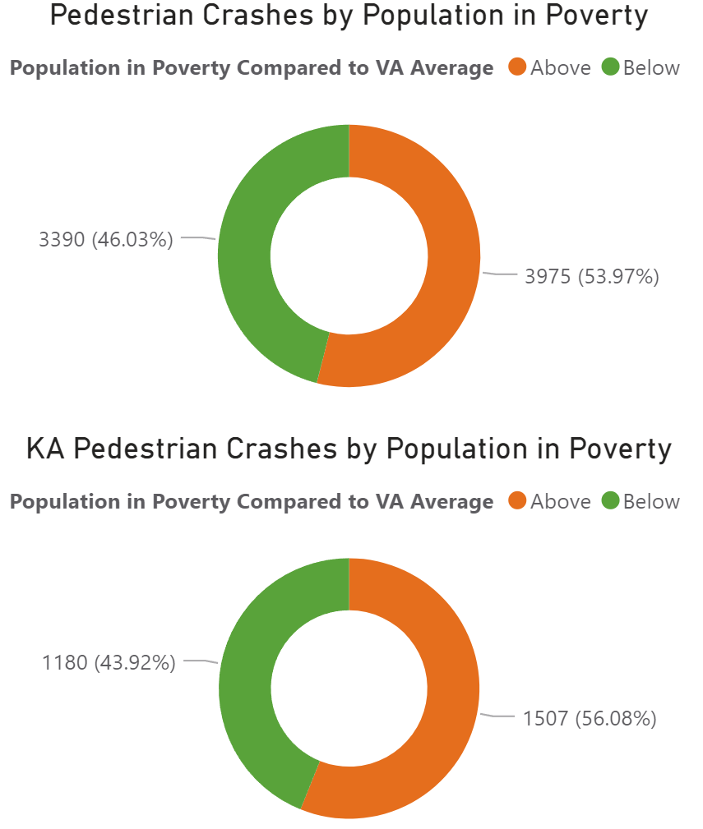
Poverty Level: Pedestrian Crashes
Pedestrian crashes were 17% higher in areas with a larger population in poverty compared to the statewide average.
F+SI pedestrian crashes were 28% higher in areas with a larger population in poverty compared to the statewide average.
Overall, pedestrian crashes and F+SI Ped crashes are over-represented in areas with a larger population in poverty.
F+SI
Population in Poverty is defined as the percentage of persons in an area (Census tract) living at or below 150% of the federal poverty line threshold established for several federal health coverage policies. Crashes in each Census tract are assessed by whether the Census tract is above or below the statewide average of Population in Poverty.
Virginia Department of Transportation

Slide 18
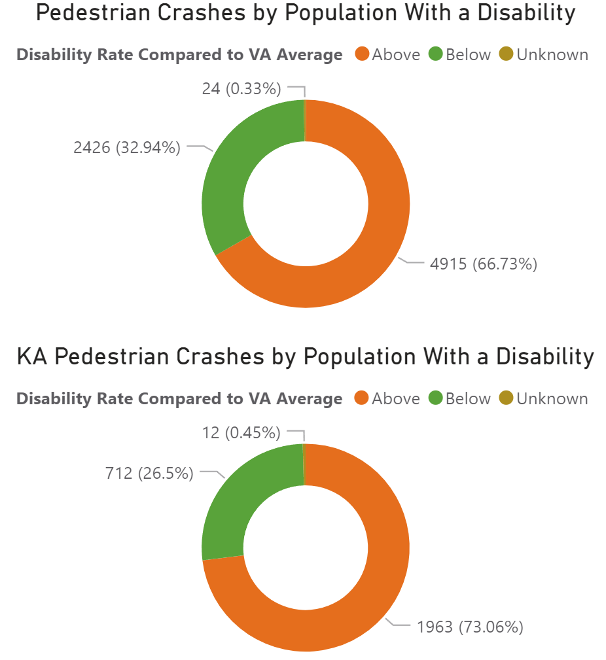
Population with Disability: Pedestrian Crashes
Pedestrian crashes were 2 times more frequent where the relative percentage of people with disability is above statewide average.
F+SI pedestrian crashes were 3 times more frequent in areas where the relative percentage of people with disability is above statewide average.
Overall, pedestrian crashes are over-represented in areas with higher disability rate.
F+SI
Population with Disability is defined as the percentage of persons in an area (Census tract) with a disability. Crashes in each Census tract are assessed by whether the Census tract is above or below the statewide percentage of population with a disability.
Virginia Department of Transportation

Slide 19
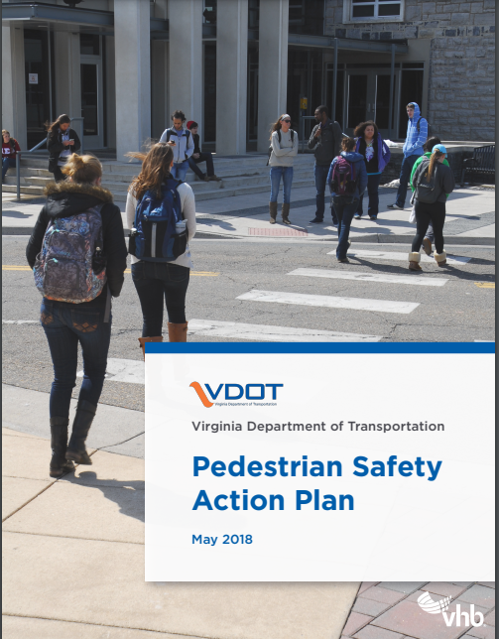
Tools: Pedestrian and Bicyclist Safety Action Plan
Predictive geospatial analysis to determine which road segments have the greatest propensity and risk for VRU travel (bicyclists were added in Version 3)
Focus on VRU safety with VDOT Policy Recommendations
VRU safety infrastructure countermeasure toolbox
2019 National Roadway Safety Award

Slide 20
Tools: PBSAP - Priority Corridor Criteria
Annual average daily traffic (AADT)
Road geometry (# lanes)
Posted speed limit
VRU crash history
Zero-vehicle households
Health Opportunity Index (HOI)
Population density
Employment density
Transit access
Proximity to parks and schools

Slide 21
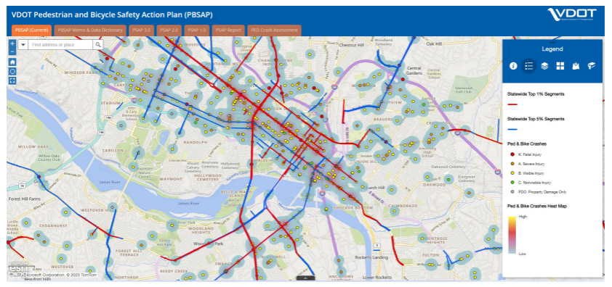
Tools: PBSAP Statewide Top Priority Corridors Map
Used to define VTrans VRU needs for SMART SCALE projects
Used to prioritize VRU Safety Improvement Program

Slide 22
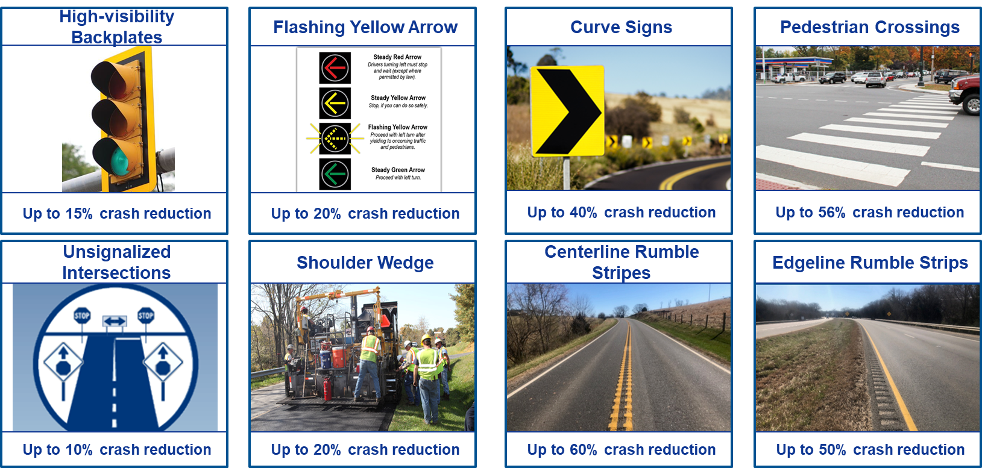
Virginia Highway Safety Improvement Program Investment Strategy
Focus on severe crashes dispersed over road network (top 1% of PBSAP)
Apply low-cost countermeasures
Wider benefit with more targeted return on investment

Slide 23
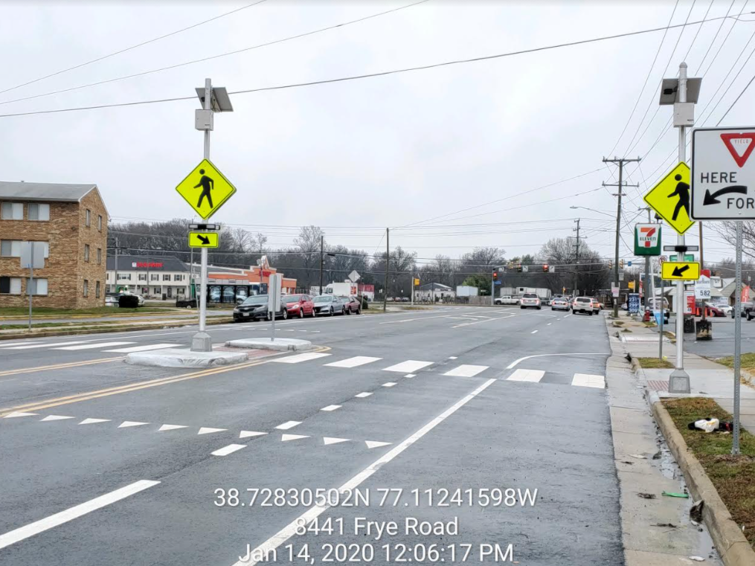
HSIP Pedestrian Safety Infrastructure Projects
Fall 2019 – Systemic Pedestrian Crossings, Phase 1
$34 million approved for pedestrian crossings at traffic signals
2025 completion date
December 2021 – Systemic Pedestrian Crossings, Phase 2
$20 million for up to 200 crossings
2028 completion date
February 2023 – Locality Systemic Funding
Pedestrian projects ~$40M
Notes:
DMV receives $10M per year is state safety funds, split as follows:
$3.4M Occupant Protection
$2.4M Impaired Driving
$3.0M Speeding
$1.2M VRU

Slide 24
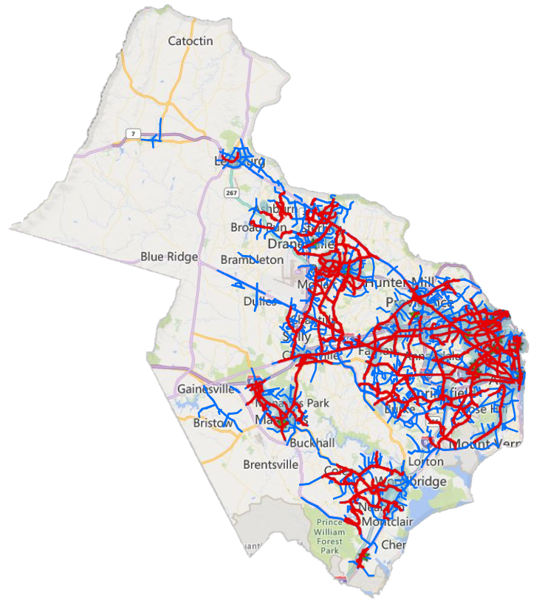
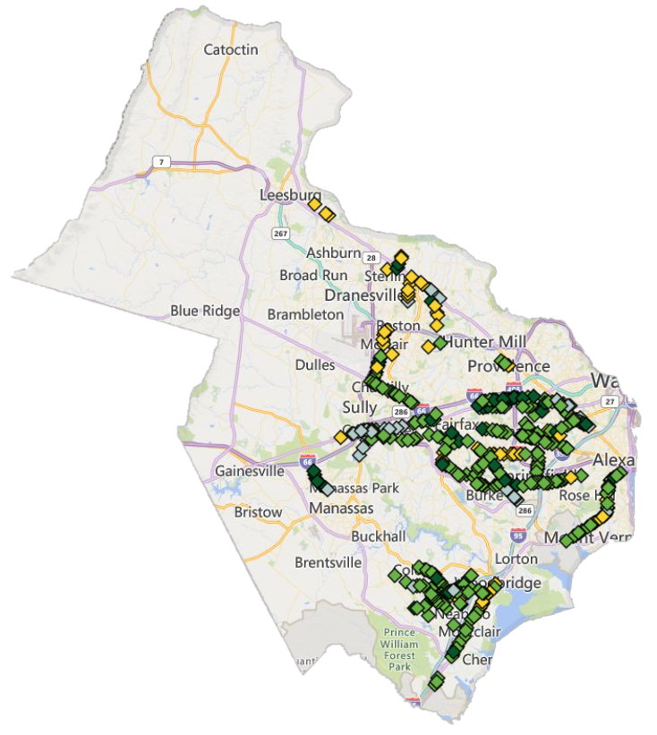
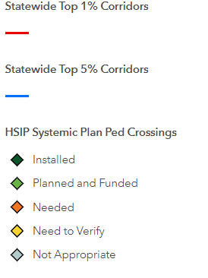
PSAP V3 Top Priority Corridors Northern Virginia District
HSIP Pedestrian Crossing Systemic Plan
Northern Virginia District

Slide 25
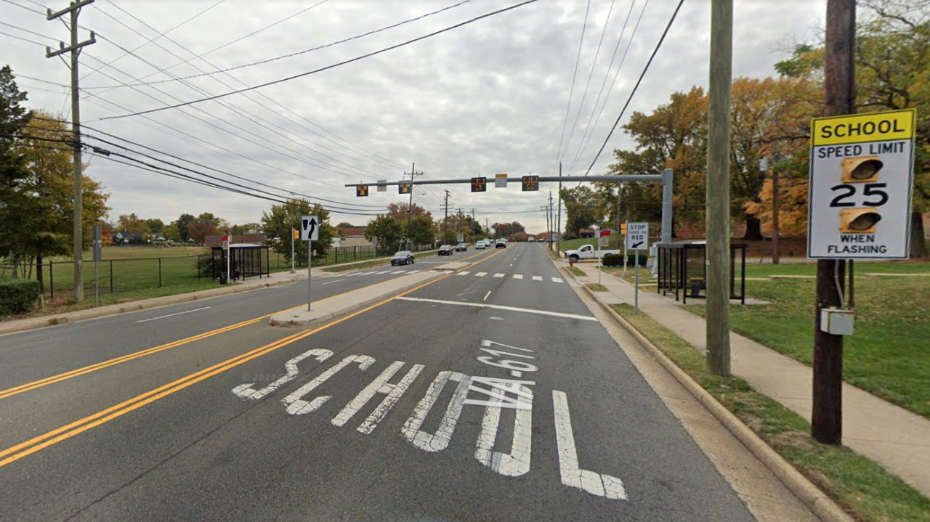
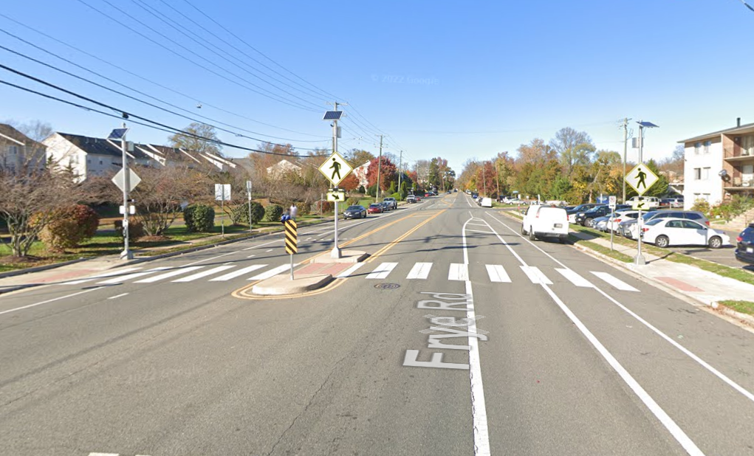
Example Safety Improvements
Mid-block Pedestrian Hybrid Beacon -
Serving school area and bus stops
Mid-block Rapid Flashing Beacon -
With bicycle lanes serving homes near US1

Slide 26
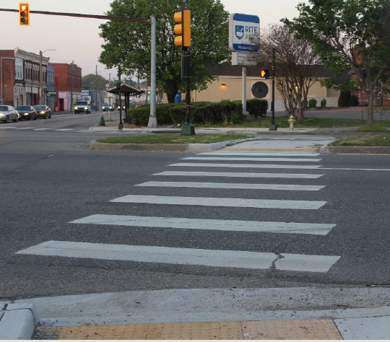
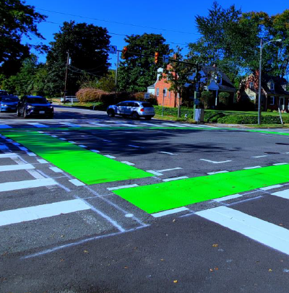
Example Richmond Improvements
10+ Miles of Road Reconfigurations -
With bicycle lanes on 3 corridors
Pedestrian Signals and ADA Features

Slide 27
Questions and Discussion
Stephen.Read@vdot.virginia.gov

